Slide 1
Ethereum & Smart Contract Development
Source of most materials:
Xiwei Xu, Ingo Weber, and Mark Staples. Architecture for Blockchain Applications. Springer, 2019

Slide 2
What will you learn today?
Ethereum Blockchain
Smart Contract Development

Slide 3
Ethereum

Slide 4
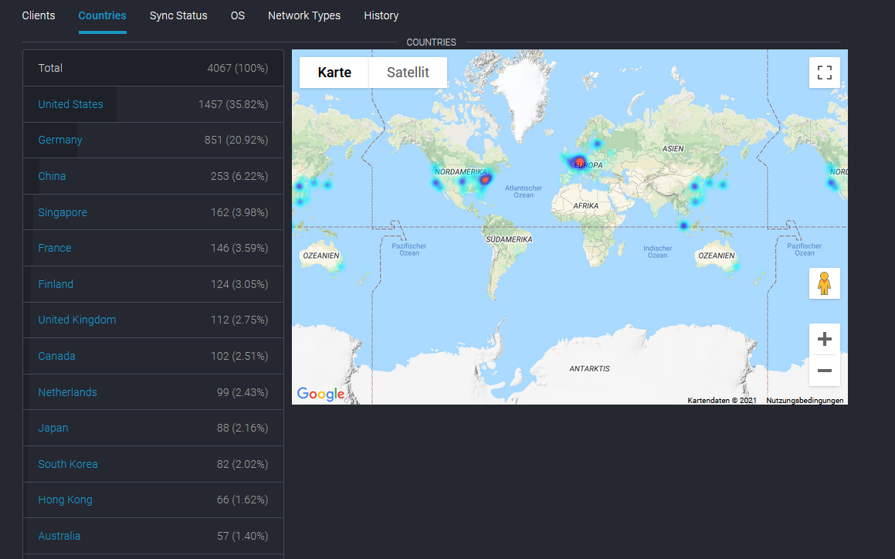
Ethereum
Network distribution
Source: https://www.ethernodes.org/countries
Notes:
This figures shows the global distribution of ethereum network. US has 42% of nodes and china has 13%. There is some overlap for the top ten countries in the ranking.

Slide 5
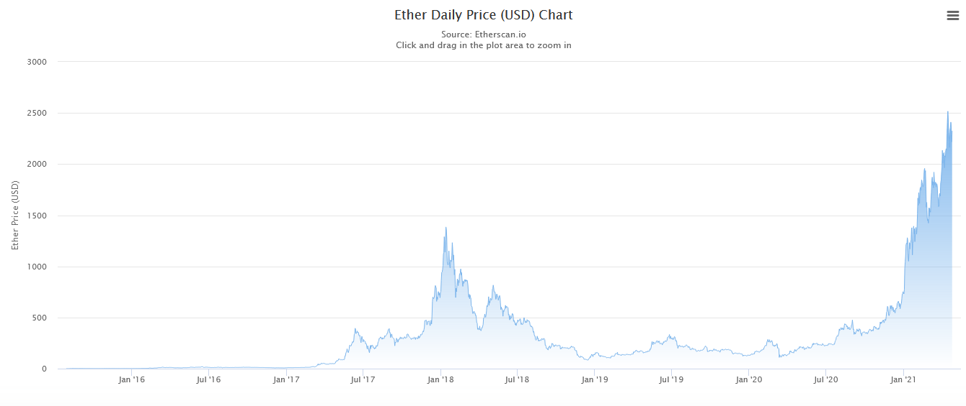
Ethereum
Exchange rate
Lowest price: $0.05
Highest price: $2517
Source: etherscan.io/chart/etherprice
Notes:
This figures shows ether historical price. The lowest price was 0.05 dollar. The highest price was around 1400 dollars, which was happened in January this year.

Slide 6
Ethereum
Proof of Work - Ethash
Shorter inter-block time: 13-15 seconds (Bitcoin: 10 mins)
The Ethereum inter-block time is significantly shorter than Bitcoin’s, typically meaning transactions are recorded and executed a lot faster on the Ethereum blockchain
According to median values, Ethereum appends a new block to its data structure every 13-15 seconds
Smaller blocks
Gas limit per block - block size limits complexity of transactions
At most 595 transactions in a block (Bitcoin: 1,500 txs/block)
Currently maximum block size is around 12,500,000 gas
Basic transactions have a complexity of 21,000 gas
Most blocks are approx. 5 KB (Bitcoin: 1 MB)
Notes:
2m
82m10s
Ethereum’s block time is shorter.
In Ethereum the time between blocks is around 14 seconds, compared with Bitcoin’s ~10 minutes.
This means that on average if you make a Bitcoin transaction and an Ethereum transaction, the Ethereum transaction would be recorded into Ethereum’s blockchain faster than the Bitcoin transaction getting into Bitcoin’s blockchain.
You could say Bitcoin writes to its database roughly every 10 minutes, whereas Ethereum writes to its database roughly every 14 seconds.
Ethereum has smaller blocks
Ethereum’s block size is based on complexity of transactions and smart contracts.
It has a gas limit per block, and the maximum can change slightly from block to block.
Currently the maximum block size in Ethereum is around 1,500,000 Gas.
Basic transactions or payments of ETH from one account to another (i.e. not a smart contract) have a complexity of 21,000 Gas
So you can fit around 70 transactions into a block (1,500,000 / 21,000).
In Bitcoin you currently get around 1,500-2,000 transactions in a block.
In Bitcoin, the maximum block size is currently 1 MB
Currently most Ethereum blocks are under 2 KB in size.

Slide 7
Ethereum
Ethereum Protocol
Ethereum’s inter-block time is not hugely longer than block propagation time around the globe
Much more likely that multiple competing blocks are created at a similar time
GHOST protocol (Greedy Heaviest Observed Subtree)
The heaviest chain wins and uncles contribute to the weight
Miners of uncle blocks receive 87.5% of a standard block reward
For every uncle included in the block, the miner gains an additional 3.125% and increases the weight of the chain including the block
Ethereum uses 3 Merkle trees, one each for integrity of:
State (account balances, data stored, etc.)
Transactions
Receipts (effects of transactions)
Notes:
So Ethereum’s inter-block time is not many times longer than the time required to propagate information to the blockchain network.
Because of that, it is much more likely in Ethereum that multiple new (competing) blocks are created concurrently at similar times.
The ghost protocol address this issue. By using this protocol, it allows shorter inter-block times which can improve throughput.
A stale block is one that was successfully created by a miner, propagated to the network and verified by some nodes as being correct,
but is eventually discarded when another longer chain achieves dominance.
In this figure, block miner b is a stale block.
It is created by miner B. At the same time block miner c is created by miner c. both of them are propagated at the same time.
block miner b is eventually discarded when the other chain is getting longer.
In the ethereum ghost protocol, the competing blocks are called uncle.
In ethereum, not the longest chain wins, but the ’heaviest’— and recognized uncles contribute to the weight.
Miners reference uncle blocks to add weight to their chain in the calculation of which chain has the highest cumulative difficulty..
This recognition is backed by a strong financial incentive mechanism.
Miners of uncle blocks receive 87.5% of a standard block reward. For every uncle included in the block the miner gains an additional 3.125%, and increases the weight of the chain including its block.

Slide 8
Ethereum
Transactions Lifecycle
Notes:
3m
This figure shows the ethereum transaction lifecycle.
After a transactions is submitted, it is broadcasted to the network and kept in the transaction pool.
Then the transaction is validated.
The validation includes checks of the digital signature, parameters such as the nonce (sequence number of transaction relative to a given source account), and if there are sufficient funds in the source account.
If it is validated, it is included in a newly mined block on some branch of the chain.
But this does not guarantee that a transaction is permanently added to the blockchain.
If the blockchain forks, the block including the transaction may simply be discarded and it could be reincluded later.
While uncle blocks maybe recognized in ethereum, the content is discarded. If all blocks that include the transactions become part of a shorter chain, then the transactions return to the transaction pool.
The transactions can also be removed from the pool, we say it is dropped.
It is impossible for any node in the network to know with certainty whether all miners have dropped the transaction.
Only when the nonce of the transaction becomes outdated, i.e. another transaction from the same source account with the same nonce has been committed, the old transaction will not be able to be included in any valid block.
Ethereum uses proof of work, like Bitcoin, and the GHOST protocol states that the longest/heaviest chain becomes the main chain. Therefore, like for Bitcoin,
Ethereum users wait for X confirmation blocks before seeing a transaction as committed.
Due to the higher rate of uncle blocks, X is typically higher than for Bitcoin: 12 blocks (block that includes the transaction + 11 confirmation blocks) are typical on Ethereum.

Slide 9



Student Task
Reflect on the lifecycle: what could go wrong?

Slide 10
Ethereum
Smart Contract (SC) in Solidity
SC creation TX: deployment
After included, identified by a SC address
A smart contract account contains
A piece of executable code
An internal storage to store internal state
An amount of Ether, i.e. contract balance
Monetary TX
Users can transfer Ether to the SC
Invoking TX contains
The interface of the function being invoked and its parameters in the data payload
An amount of Ether as gas for the TX execution
Signature of the TX sender authorizes the TX
Notes:
As shown in the figure, There are three types of smart contract relevant transactions.
The signature of the transaction sender authorizes the transaction.
a smart contract is deployed on the blockchain through a contract creation transaction.
The data payload of the transaction contains the object code of the smart contract.
After the contract creation transaction is successfully included in to the blockchain, the smart contract is identified by a contract address.
Every smart contract has a blockchain account which can hold Ether and internal state.
Thus, an Ethereum smart contract account contains:
- a piece of executable code,
- an internal storage to store its internal state, and
- an amount of Ether, i.e., the contract balance.
After a smart contract is successfully deployed on blockchain, blockchain users can transfer Ether to the smart contract by using a basic monetary transaction.
Smart contracts are programs that need to be externally invoked.
Blockchain users can invoke the functions defined in the smart contract by sending contract invoking transaction to the address of the smart contract.
The functions defined in a smart contract can also be invoked by other smart contracts.
The contract-invoking transaction contains
the interface of the function being invoked and its parameters in the data payload
an amount of Ether as gas for the execution of the invoked functions.
The signature of the transaction sender authorizes the data payload of the transaction to execute a smart contract.

Slide 11
Reads and Writes on Ethereum
The notion of reads and writes is not broadly discussed in most writing about blockchains, but thinking in these categories helps when designing apps
Read operations do not change the state, write operations do
Read examples
What is the balance of account 0x123… ?
What is the value of variable x in smart contract 0x987… ?
How many people have voted for option 1?
Can be done as smart contract call
No need to burden the network with reads → there are no “read transactions”
You can read from your own local node, or rely on third parties, e.g. https://www.etherscan.io , but calling contracts often requires an own node
Write examples
Transfer x Ether from account 0x123… to 0x987…
Set variable x in smart contract 0x987… to 42
This is a smart contract invocation, requires sending a transaction
Vote for option 3
(Depending on your view: creating / mining a new block can be considered a write)
You can send a transaction from your local node or through others, but you typically need some program to assemble the transaction

Slide 12
Ethereum
Paying Fees in “Gas”
Gas: a fee to limit the resource usage
Gas cost
A fixed gas cost per transaction (base cost)
Variable gas cost for data (dependent on its size) and execution of a smart contract method (charged per bytecode instruction)
Additional gas cost for the deployment of new contracts
Gas cost is converted to Ether according to a user defined gas price –how much ether per gas the TX creator is willing to pay
By default, clients may set the gas price to a market price
Users set higher gas price if inclusion of transaction is urgent, or lower gas price if transaction inclusion is not (time-) critical
Gas price recommendations available e.g. from ETH Gas Station https://ethgasstation.info/
Notes:
A smart contract on the Ethereum blockchain is locally executed by every miner, and so consumes their computational resources.
In a Turing-complete language, it is not always possible to predict the computational resources that will be required by a program, or even whether the program will terminate. It is important that the replicated execution of a non-terminating program does not freeze the whole network.
To limit the use of resources, and to compensate miners for the use of their computational resources, Ethereum uses the concept of gas, as a fee proportional to
the required data storage and computation.
There is a fixed gas cost for each transaction, plus variable gas cost for data (proportional to its size) and execution of a smart contract method (charged per bytecode instruction). There is an additional gas cost for the deployment of new contracts.
The Ethereum yellow paper defines a detailed cost model. All costs in Ethereum follow a pricing table, specified in the unit gas. Gas cost is converted to Ether according to a user-defined gas price, i.e., how much Ether-per-gas the creator of a transaction is willing to pay. By default, Ethereum clients set the gas price to a market rate, an average over previously-included transactions. The gas price can be set to 0, meaning the transaction sender is not offering a fee. Intuitively, users set higher gas prices if inclusion of their transaction is urgent for them, and lower gas prices if inclusion can take time or may altogether — but this intuition does not always match reality.
Other than gas price, when users send contract-invoking transactions, a gasLimit must be set, which bounds the computation for a smart contract. The miner who successfully includes the transaction in the blockchain receives a transaction fee corresponding to the amount of gas the execution has actually used, multiplied by the gas price. An execution which requires more gas than gasLimit causes an exception, and the state of the smart contract is rolled back to the state before the execution.
To prevent denial-of-service attacks, Ethereum also defines a gas limit at the block level: the sum of gas used by the transactions included in a block cannot exceed this limit. The block gas limit is influenced by the miners, where each miner winning a block can vote to increase, decrease, or keep the current block gas limit. However, the block gas limit also limits the complexity for blocks which also bounds throughput.

Slide 13
Student Task
Imagine you have to calculate the transaction fee (write the code for the client)
How would you do it?
3 minutes of discussion in breakout groups

Slide 14
Ethereum
Data structure of a transaction
An Ethereum transaction has the following fields
From – source address (regular account)
To – destination address (regular account or contract address)
Value – Ether (in unit “wei”) to transfer to the destination (can be 0)
Nonce – transaction sequence number for the sending account
Gas price – price you are offering to pay (Ether per gas)
Gas limit – maximum amount of gas allowed for the transaction (called “startgas”)
Data – payload data, e.g., description of transaction, binary code to create smart contract, or function invocation
Digital signature (field names: v, r, s)
Once included, additional information (block number, actual gas used, actual fee, etc.) is available
See e.g. https://etherscan.io/tx/0x5c504ed432cb51138bcf09aa5e8a410dd4a1e204ef84bfed1be16dfba1b22060

Slide 15
Ethereum
Different networks and testing options
To deploy a smart contract or submit a transaction, you can:
Use the Ethereum mainnet
But you need actual Ether
Use a testnet
Currently there are 4 – see https://docs.ethhub.io/using-ethereum/test-networks/
Create your own testnet
With one or more full nodes
Be sure to never reuse genesis block / network ID
Use Ganache
Simulates a stateful blockchain system, on your own machine
https://docs.ethhub.io/ethereum-basics/development/testing/
Run tests in Remix IDE or use the Truffle framework
https://docs.ethhub.io/ethereum-basics/development/testing/

Slide 16
Smart Contract Development

Slide 17
Recap: Dapps and Smart Contracts
Smart contracts
Programs deployed as data and executed in transactions on the blockchain
Blockchain can be a computational platform (more than a simple distributed database)
Code is deterministic and immutable once deployed
Can invoke other smart contracts
Can hold and transfer digital assets
Decentralized applications or dapps
Main functionality is implemented through smart contracts
Backend is executed in a decentralized environment
Frontend can be hosted as a web site on a centralized server
Interact with its backend through an API
Could use decentralized data storage such as IPFS
“State of the dapps” is a directory recorded on blockchain: https://www.stateofthedapps.com/
Notes:
Decentralized applications or Dapps are applications that are designed to provide their main functionality through smart contracts
Smart contracts are programs deployed as data in the blockchain ledger, and executed in transactions on the blockchain.
Smart contracts can hold and transfer digital assets managed by the blockchain, and can invoke other smart contracts stored on the blockchain. Smart contract code is deterministic and immutable once deployed.
The Bitcoin blockchain allows only very simple forms of smart contracts, but other blockchains such as Ethereum allow computer programs to be written in a “Turing complete” language. In principle, it can be as expressive as every other general purpose programming language. As a result, blockchains can be more than a simple distributed database — they can be general computational platforms.
40s

Slide 18
Smart Contracts in general
Analogy: Java program
Smart contract code: a class
Deployed contract: an object
Many software design patterns still apply, e.g., Factory
Code is deterministic, i.e., same state/inputs result in the same state changes/outputs
However, state may not be deterministic from viewpoint of the caller (e.g. block number)
Why can smart contract execution be trustworthy?
A contract is deployed as data in a transaction and thus immutable
All their inputs are through transactions and the current state
Their code is deterministic
The results of transactions (including function calls) are captured in the state and receipt trees, which are part of the consensus
If other nodes get a different result, they would reject a proposed block

Slide 19
General remarks about developing smart contracts
Code is immutable!
Consequences:
Follow all security best practices
Test heavily
Do code reviews
Build in features for updating as needed and acceptable for the user base
Governance for updates, e.g.: updates will become active only after 1 week / 1 month, …
Understand all (relevant) parts of the blockchain system – if you get it wrong, there is no safety net
Design includes potentially hard trade-offs between confidentiality and transparency, though patterns exist for resolving parts of those

Slide 20
Smart Contract Development in Ethereum
Smart contracts in Ethereum are deployed and executed as byte code
Runs on the Ethereum Virtual Machine (EVM)
Typically, byte code results from compiling code in a high-level language
Most popular language for Ethereum: Solidity
High-level, object-oriented language; syntax is similar to that of JavaScript
Statically typed, supports inheritance, libraries and complex user-defined types
Useful links:
In-browser IDE: https://remix.ethereum.org/
Solidity official documentation page: https://solidity.readthedocs.io/en/latest/
Official tutorials / examples: https://solidity.readthedocs.io/en/latest/solidity-by-example.html
Other tutorials, e.g.: https://ethereumbuilders.gitbooks.io/guide/content/en/solidity_tutorials.html
Smart contract best practices from Consensys (a company) https://consensys.github.io/smart-contract-best-practices/

Slide 21
Solidity
Example
pragma solidity >=0.4.0 <0.6.0; // compiler instruction: language and version
contract SimpleStorage {
uint storedData; // variable declaration
// getter, callable by anyone on the network
function get() constant returns (uint retVal) {
return storedData;
}
// setter, callable by anyone on the network
function set(uint x) {
storedData = x;
}
}

Slide 22
Solidity
Features
Object-oriented, high-level language
Statically typed, supports inheritance, libraries and complex user-defined types
Multi-inheritance is supported
Designed for smart contracts to run on the Ethereum Virtual Machine (EVM)
Syntax is closest to JavaScript, with some similarity to Java
But no support for Lambda expressions (anonymous methods without a declaration)
Also influenced by C++, Python
Each deployed contract is assigned an address (like a regular account)
Can receive, hold, and spend assets, like Ether
Assets held by the account address are controlled by the program code
Bugs / vulnerabilities / omissions can lead to permanent loss of assets
But: untrusting parties can use smart contract as neutral, trustworthy middle ground
Follow best practices, especially around security – there is no “safety net”

Slide 23
Solidity
Features
Deploy contract by sending a transaction with recipient “to” set to “null”
Can specify interfaces, by having at least one un-implemented function
contract base { function foo(); } // an interface
contract derived is base { function foo() {} } // implements the interface
Can overload functions (same function name but different parameters)
But might not be a good idea – harder to understand the code
Arrays work in the usual Java/JavaScript-like way
Constructor is executed when a contract is created is executed once
Function name: constructor
uint[3] public data; data[0] = 0; …
contract Base {
constructor(uint i) public {…}
}

Slide 24
Solidity
Remix example
pragma solidity >=0.4.22 <0.6.0;
contract Ballot {
struct Voter {
uint weight;
bool voted;
uint8 vote;
address delegate;
}
struct Proposal {
uint voteCount;
}
address chairperson;
mapping(address => Voter) voters;
Proposal[] proposals;
/// Create a new ballot with $(_numProposals) different proposals.
constructor(uint8 _numProposals) public {
chairperson = msg.sender;
voters[chairperson].weight = 1;
proposals.length = _numProposals;
}
//...
}
// From https://remix.ethereum.org/

Slide 25
Solidity
Remix test example
import "remix_tests.sol"; // this import is automatically injected by Remix.
import "./ballot.sol"; // the file to test
contract test3 {
Ballot ballotToTest;
function beforeAll () public {
ballotToTest = new Ballot(2);
}
function checkWinningProposal () public {
ballotToTest.vote(1);
Assert.equal(ballotToTest.winningProposal(), uint(1),
"1 should be the winning proposal");
}
function checkWinningProposalWithReturnValue () public view returns (bool) {
return ballotToTest.winningProposal() == 1;
}
}
// From https://remix.ethereum.org/

Slide 26
Solidity
Visibility of data / functions
Solidity provides two types of function calls: internal and external
Internal call: local call from the same contract
External: by message call
Functions can be specified to be external, public, internal or private
External: only from outside (transactions or other contracts); part of the contract interface
If function f is external, calling it internally is impossible (for example, f() will not work, however, this.f() works).
Public: can be called both by message calls and internally; part of the contract interface
Used to be the default, but compiler now enforces explicit declaration
Internal: only from other code in the same contract (including by inheritance)
Private: only be visible for the contract that they are declared in, and not even in derived contracts
No data is ever really private in smart contracts – anyone on the network can extract it
For state variables, external is not possible and the default is internal
Compiler automatically creates getter functions for public variables

Slide 27
Solidity
Visibility of data / functions - example
pragma solidity ^0.5.1;
contract cont1 {
uint private data;
function func(uint x) private returns(uint y) { return x + 1; }
function dataSet(uint x) public { data = x; }
function dataGet() public returns(uint) { return data; }
function compute(uint x, uint y) internal returns (uint) { return x+y; }
}
contract cont2 {
function dataRead() public {
cont1 z = new cont1();
uint local = z.func(7); // error: member "func" is not visible
z.dataSet(3);
local = z.dataGet();
local = z.compute(3, 5); // error: member "compute" is not visible
}
}
contract cont3 is cont1 {
function g() public {
cont1 z = new cont1();
uint val = compute(3, 5); // access to internal member (from derived to parent contract)
}
}
// Adapted from https://www.bitdegree.org/learn/solidity-visibility-and-getters

Slide 28
General principles for Ethereum smart contracts
Follow the KISS principle: keep it simple, stupid (Navy quote, not meant as insult)
... and readable / understandable, so other devs/technical users can build trust in your code
Follow best practices, especially around security – there is no “safety net”
Interface of a smart contract is NOT visible from the deployed code
No requirement of the binary code to have a particular structure
But Solidity compiler establishes a particular structure
This structure needs to be known to the caller – i.e., the transaction invoking a smart contract method must be aware of this structure and be constructed accordingly
Signatures can be guess-extracted (but not necessarily the function names), if the binary code was written in Solidity and compiled with the standard compiler
Cannot rely on it not becoming known (as always, avoid “security by obfuscation”)
Make the code available to the potential users (e.g., open source), or at least the interface
Many interface standards proposed, e.g., ERC-20 for fungible tokens
Always look at the online documentation: Solidity is under very active development and changes are frequent

Slide 29
Summary
Basic concepts of the Ethereum blockchain
Principles on smart contract implementation

Slide 30
Ethereum & Smart Contract Development
Source of most materials:
Xiwei Xu, Ingo Weber, and Mark Staples. Architecture for Blockchain Applications. Springer, 2019

